Slide 1
Manipulating Electromagnetic Local Density of States by Graphene Plasmonics
Presenter: Wei E.I. Sha
Electromagnetics and Optics Lab
Dept. of EEE, The University of Hong Kong, Hong Kong
Personal Website: http://www.eee.hku.hk/~wsha/
Collaborators：
Dr. Yongpin Chen, University of Electronic Science and Technology
Prof. Jun Hu, University of Electronic Science and Technology
Prof. Li Jun Jiang, The University of Hong Kong

Slide 2
OUTLINE
1. Significance and History
2. Quantum Electrodynamics
3. Spontaneous Emission, Local Density of States, and Green’s Tensor
4. Graphene Plasmonics to Control the Local Density of States
5. Conclusion

Slide 3
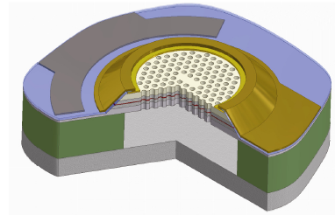
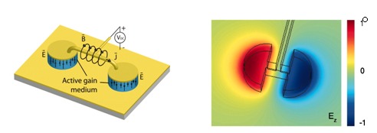
Why spontaneous emission (decay) is important?
Control of spontaneously emitted light lies at the heart of quantum optics. It is essential for diverse applications ranging from lasers, light-emitting diodes, solar cells, and quantum information.
Purcell factor
LED (photonic crystal cavity)
Laser (metallic microcavity)
M. Francardi et al. Appl. Phys. Lett.
93, 143102 (2008)
C Walther et al. Science 327, 1495-1497 (2010)

Slide 4
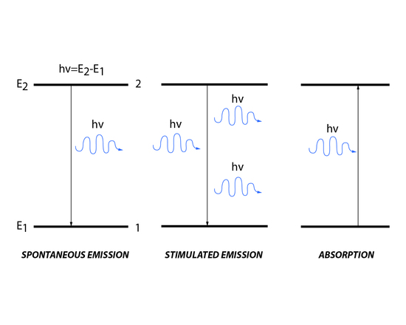




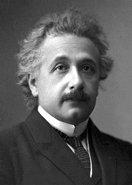
History of spontaneous EMISSION rate
proportion to photon intensity
Classical View:
Boltzmann statistics
spontaneous emission: an exited atom/molecule decay to the ground state and emits a photon

Slide 5
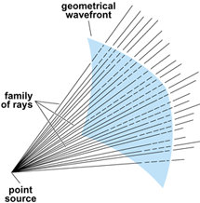
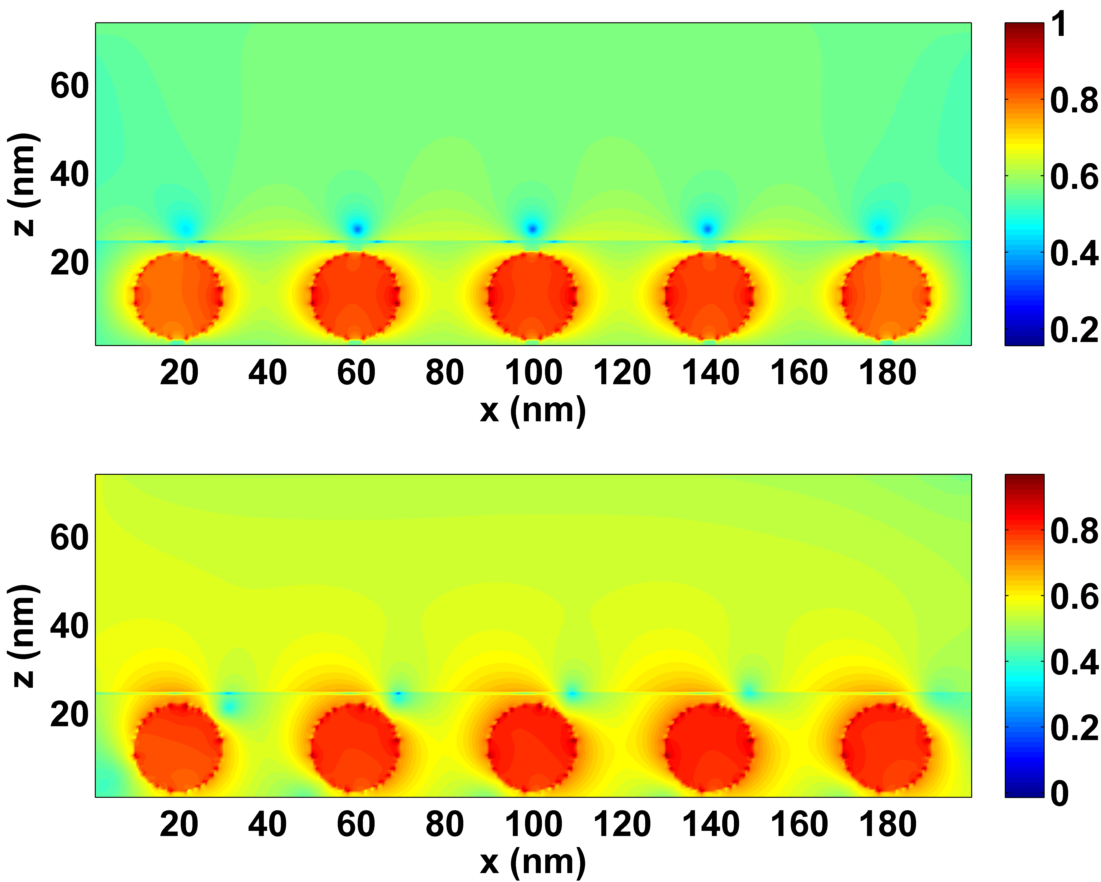
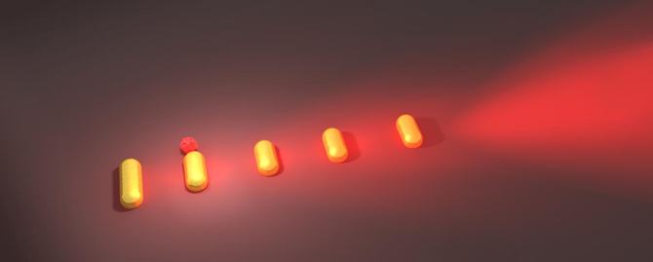
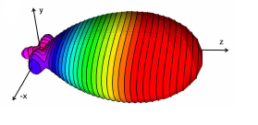
THREE Regimes in optics
classical optics
ray physics
D>>λ
nano-optics
wave physics
D~λ
quantum optics
quantum physics
D<<λ
At quantum regimes, the object size (<10 nm) is quite small compared to wavelength. In this situation, semi-classical Maxwell-Schrödinger system is required to describe the EM—particle interaction. Moreover, if the number of photons is also quite small, Maxwell’s equations should be quantized.

Slide 6









A modern interpretation: quantum electrodynamics (1)
Quantized form of Maxwell Equations
Quantized Hamiltonian
eigenmodes
wave-particle duality
non-interaction part
interaction part
Coulomb gauge
perturbation method could solve it!
wave function
e: excited state of atom; g: ground state of atom; 0: no photon; 1: one photon

Slide 7


A modern interpretation: quantum electrodynamics (2)
Spontaneous emission rate by Fermi golden rule
Mode expansion of dyadic green’s function
Representation by Green’s tensor
Electromagnetic Local density of state (EMLDOS)
Purcell factor

Slide 8
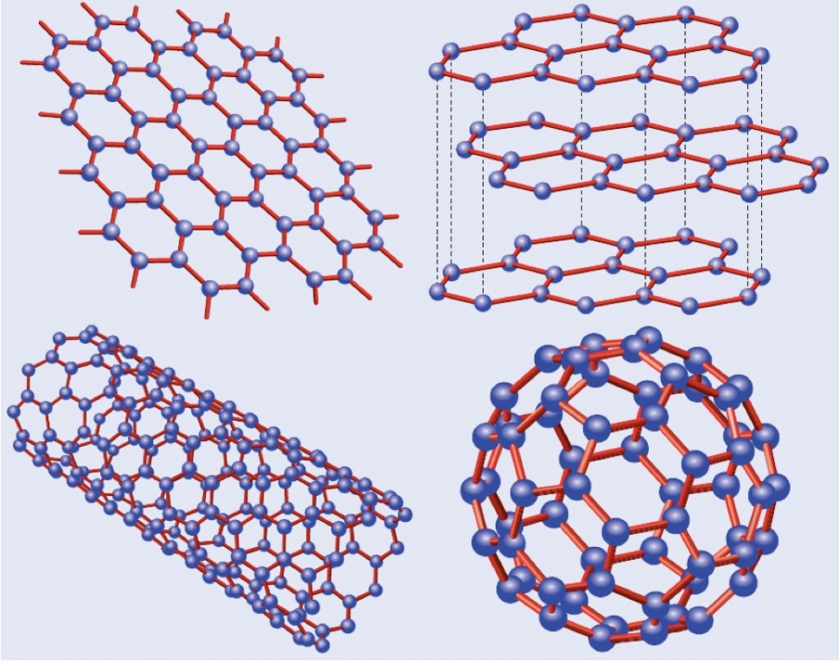
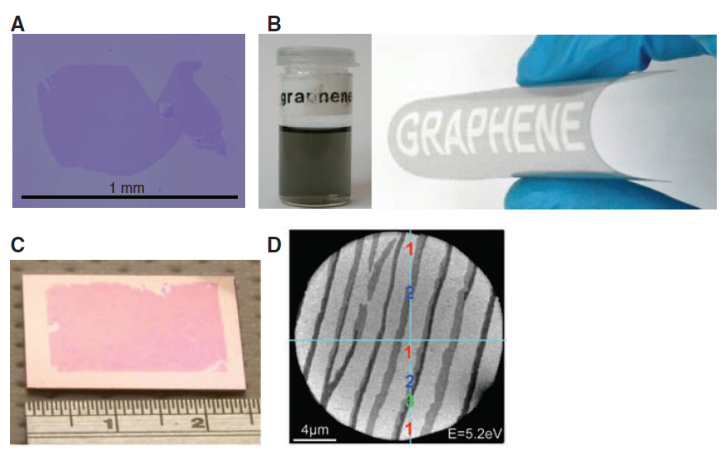
Graphene
Atomic thickness;
High optical transmittance and conductivity;
Dynamically modify chemical potentials through tuning the gate voltage
Graphene
Graphite
Carbon Nanotubes
Fullerences (C₆₀)
Fabrication
Physics World 19, 33 (2006)

Slide 9
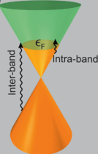
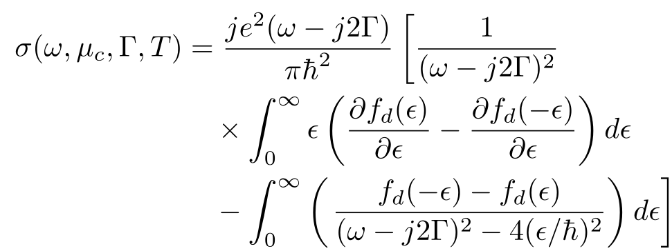

Formulations for graphene permittivity
Surface conductivity of Graphene given by Kubo formula
Intraband Relaxation
(plasmonic effect)
Interband Transition
(Be neglectable at THz frequencies)
ω-Frequency, µc-Chemical potential, Γ-Carrier scattering rate and T- Temperature;
Where Fermi-Dirac distribution f_{d} is
Converts the surface conductivity to volume conductivity in modeling;
Notes:
Due to the forbidden interband transitions by the Pauli blocking, the chemically or electrostatically doped graphene can support strong plasmonic effects particularly at the far-infrared or terahertz regime

Slide 10
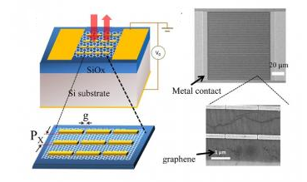
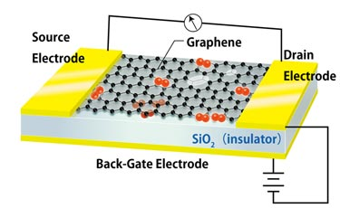
When graphene is applied to control Spontaneous Emission
Quantum Electrodynamics Computational Electromagnetics
Spontaneous Emission Numerical Green’s Function
Low-Dimensional Materials
Electrically Tunable Active Materials

Slide 11
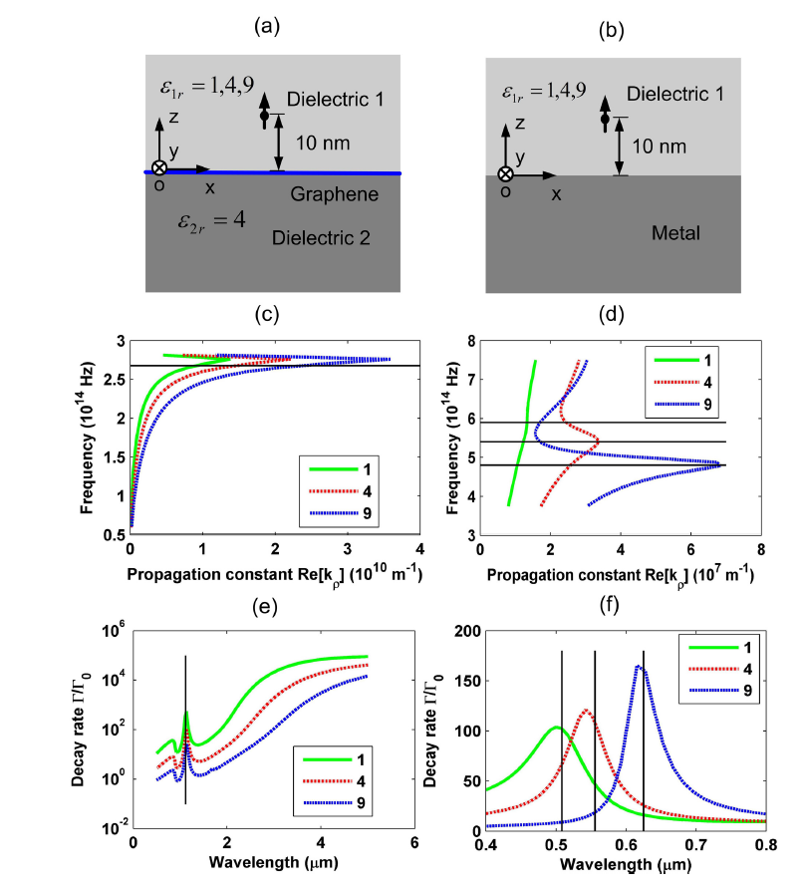
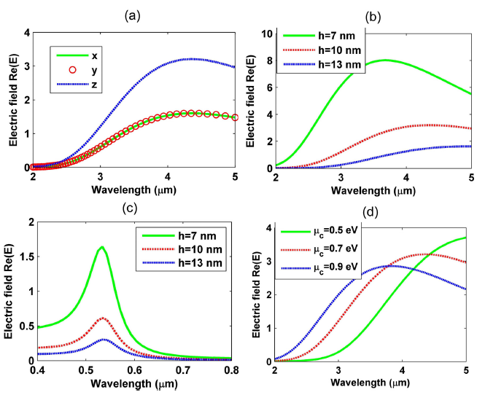
Graphene vs metal for controlling Spontaneous emission
sensitive to polarization
sensitive to position
tunable by chemical potential
much larger enhancement than metals

Slide 12
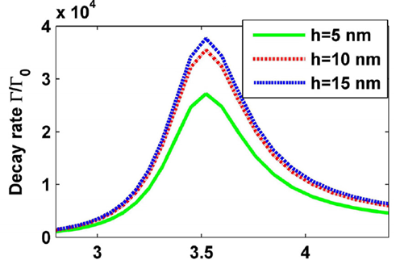
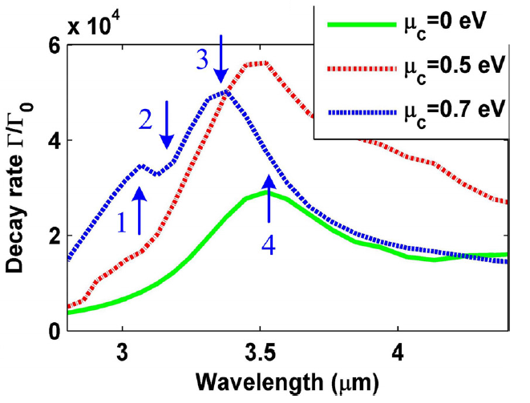

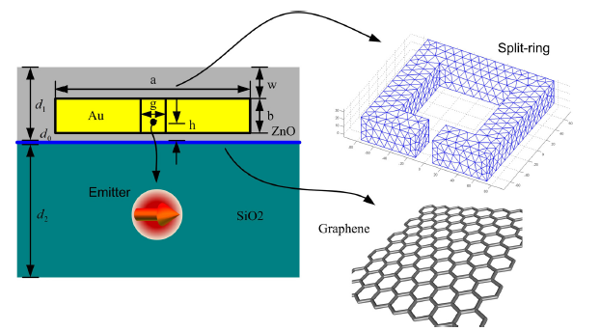
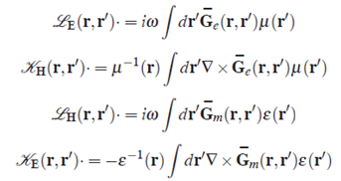

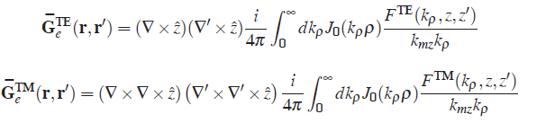
spontaneous Emission in complex multilayer nanostructure
split ring + graphene
split ring only
equivalent principle (PMCHWT) + multilayer Green’s function

Slide 13
Publications
Pengfei Qiao, Wei E.I. Sha, Wallace C.H. Choy, and Weng Cho Chew, “Systematic Study of Spontaneous Emission in a Two-Dimensional Arbitrary Inhomogeneous Environment,” APS, Physical Review A, vol. 83, no. 4, pp. 043824, Feb. 2011.
Yongpin P. Chen, Wei E.I. Sha, Wallace C.H. Choy, Li Jun Jiang, and Weng Cho Chew, “Study on Spontaneous Emission in Complex Multilayered Plasmonic System via Surface Integral Equation Approach with Layered Medium Green’s Function,” OSA, Optics Express, vol. 20, no. 18, pp. 20210-20221, Aug. 2012.
Yongpin P. Chen, Wei E.I. Sha, Li Jun Jiang, and Jun Hu, “Graphene Plasmonics for Tuning Photon Decay Rate near Metallic Split-Ring Resonator in a Multilayered Substrate,” OSA, Optics Express, vol. 23, no. 3, pp. 2798-2807, Feb. 2015.
Weng Cho Chew, Wei E. I. Sha, and Qi I. Dai, “Green’s Dyadic, Spectral Function, Local Density of States, and Fluctuation Dissipation Theorem,” http://arxiv.org/pdf/1505.01586.pdf

Slide 14
Conclusion
1. Graphene offers several flexible tuning routes for manipulating EMLDOS, including tunable chemical potential and the emitter’s position and polarization. It shows broadband enhancements of EMLOS compared to metal materials.
2. We study spontaneous emission rate of a quantum emitter near a metallic split-ring resonator, which is embedded in a multilayered substrate incorporating a graphene layer. This design enables a mutual interaction between graphene plasmonics and metallic plasmonics. The boundary element method with a multilayered medium Green’s function is adopted in the numerical simulation.
3. Strong plasmonic coupling with a switch on-off feature was observed, which is helpful to dynamically manipulate spontaneous emission rate in complex optical devices.

Slide 15
THANKS FOR YOUR ATTENTION!

