Slide 1
Unidirectional and Wavelength Selective Photonic Spherical Nanoantennas
Yang G. Liu, Wallace C.H. Choy, Wei E.I. Sha, and Weng Cho Chew
Department of Electrical and Electronic Engineering,
The University of Hong Kong, Hong Kong
Email: wsha@eee.hku.hk (W.E.I. Sha)

Slide 2
Outline
Introduction
T-matrix method
Theoretical results
Summary

Slide 3
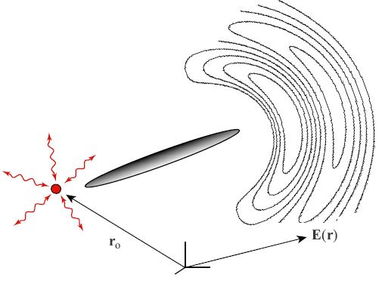
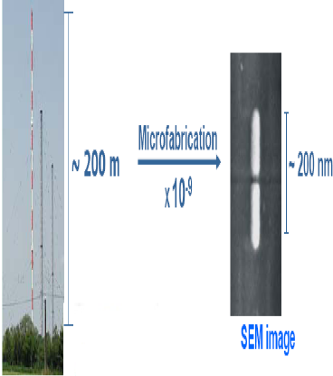
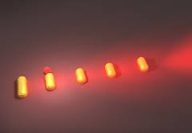
Introduction
  Nanoantenna (NA), to some extent, is a direct analogue and extended technology of the radio wave and microwave antenna. They play a fundamental role in the nanotechnology due to their capabilities to confine and enhance the light through converting the localized to propagating electromagnetic fields, and vice versa. Developing a directional NAs to redirect the emission from an ensemble of atoms or molecules with random dipole orientations is particularly important to photon detection and sensing, spectroscopy and microscopy, and spontaneous emission manipulation. Although various plasmonic NAs have been reported in the literature to realize the directional functionality, they suffer from a fundamental limit due to intrinsic metallic loss. Photonic NAs could reduce the ohmic loss and maintain other useful functionalities of plasmonic NAs.

Slide 4

A Hertzian dipole source
A Hertzian dipole source in free space can be described as
Position vector of the dipole source
Direction of the Hertzian dipole
Current moment
Delta function

Slide 5
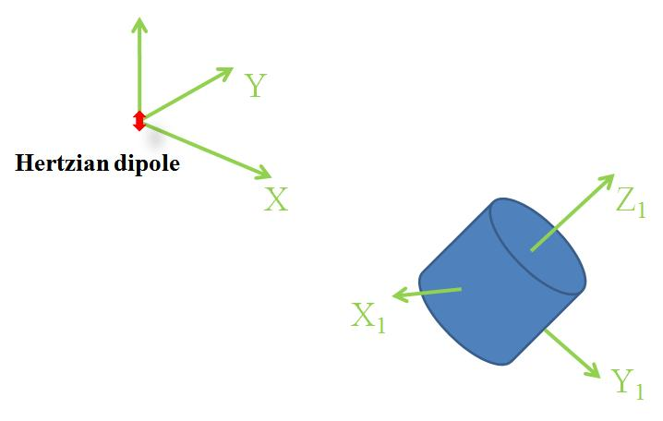
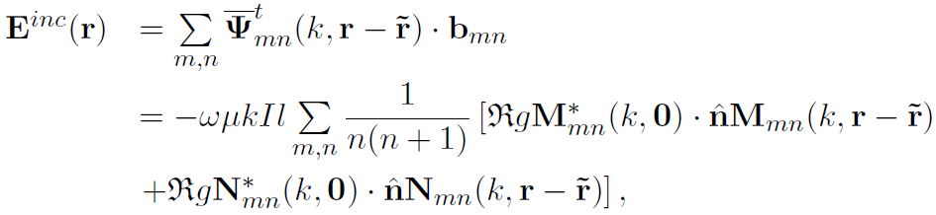
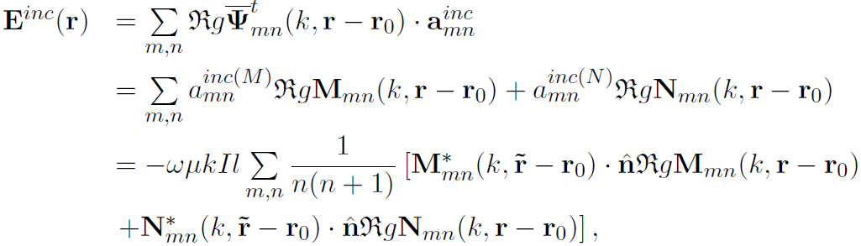
T-matrix method for a particle (1)
The incident field can be written as
Take the position of dipole source as the origin
The incident field can be rewritten as
Take the position of particle as the origin
Addition theorem
(outgoing → incoming)

Slide 6

T-matrix method for a particle (2)
The scattered field
With the continuity of tangential part of electrical field and magnetic field on the particle surface
Scattered field coefficient
incident field coefficient
T-matrix

Slide 7
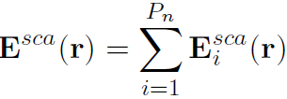

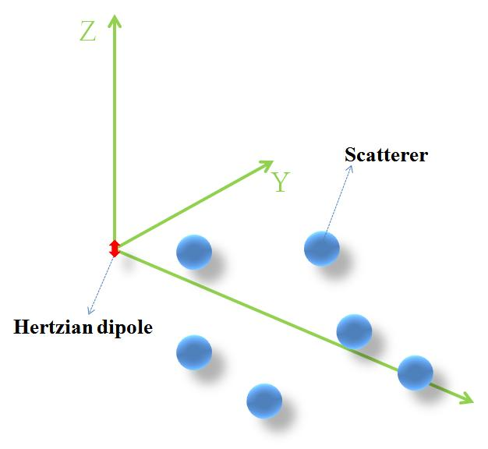
T-matrix method for multiple particles (1)
For P_{n} particles, the total scattered field is
The scattered field of the i-th particle

Slide 8
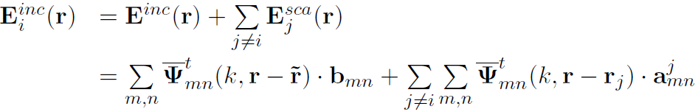
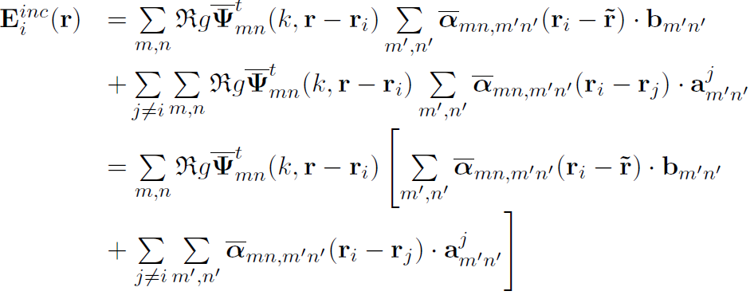
T-matrix method for multiple particles (2)
For the i-th particle, the total incident field
From the Hertzian dipole source
From all the other particles
The total incident field can be rewritten as
Addition theorem

Slide 9
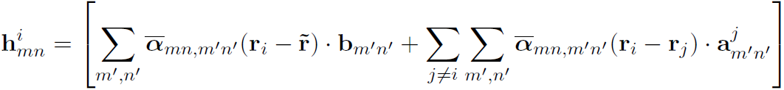
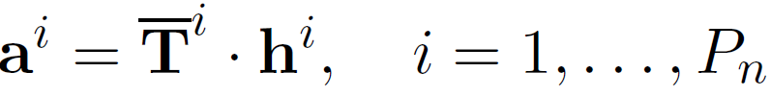
T-matrix method for multiple particles (3)
The coefficient vector of the total incident field for the i-th particle
T-matrix for the i-th particle
T-matrix method is a rigorous, fast and efficient tool for describing
the optical response of spherical nanoparticles.

Slide 10
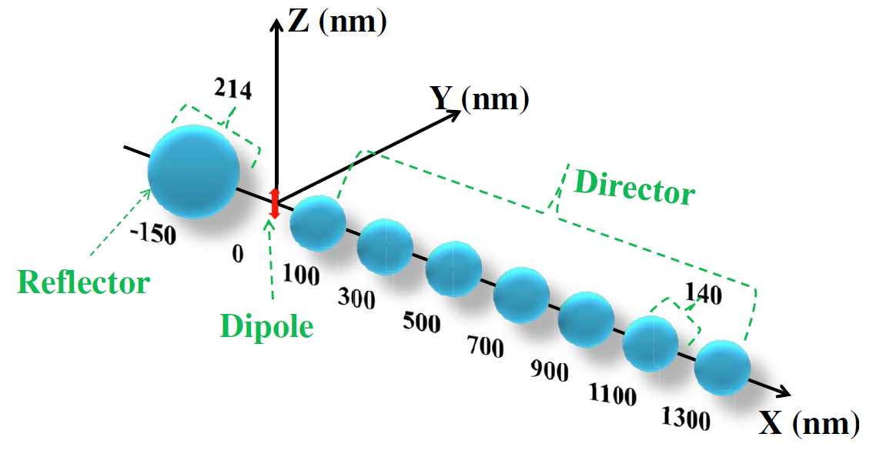
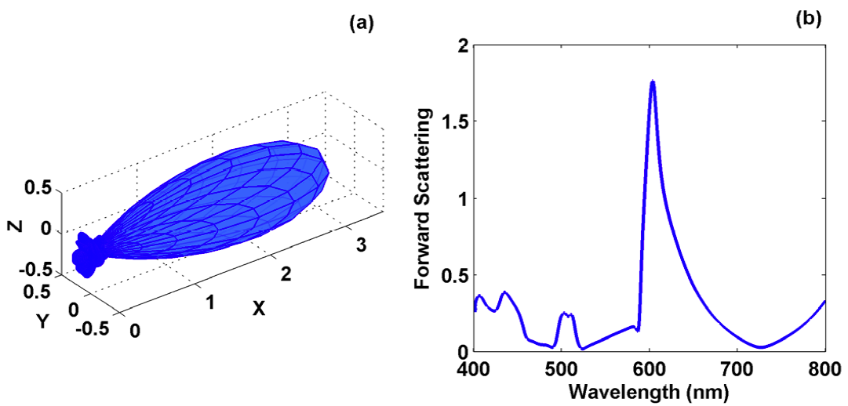
Theoretical results (1)
Fig. 1. The schematic design for an optimized photonic spherical NA at a selected wavelength of 603 nm
Fig. 2. (a) The radiation pattern of the optimized photonic NA at a selected wavelength of 603 nm;
(b) The forward scattering intensity (along the x direction) of the photonic NA as a function of the wavelength.
Y.G. Liu, W.C.H. Choy, W.E.I. Sha, and W.C. Chew, Opt. Lett., 37(11), 2112-2114, 2012.

Slide 11
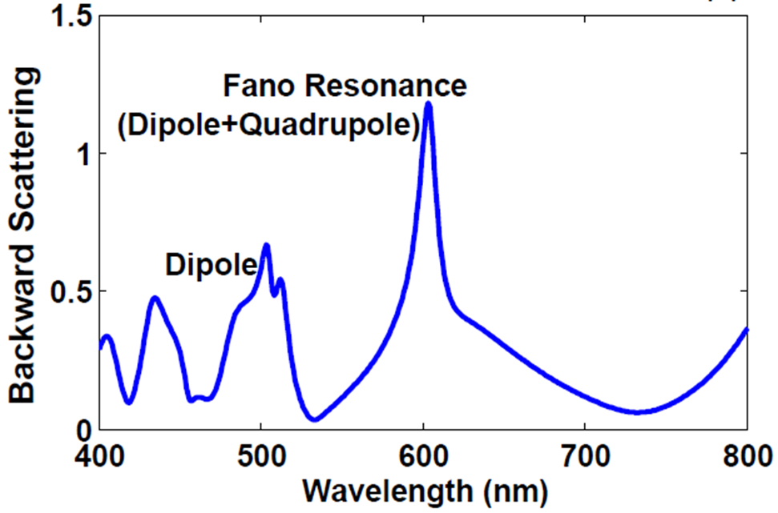
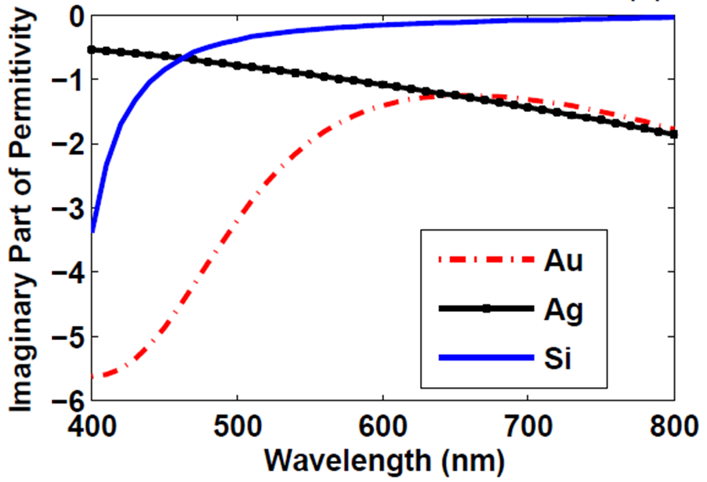
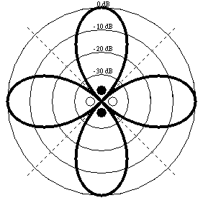
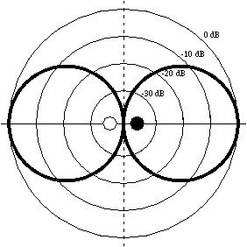
Theoretical results (2)
interferences by two resonant channels
Fig. 3. The backward scattering intensity of a silicon nanosphere (with the radius of 107 nm) as a function of the wavelength
Fig. 4. The imaginary parts of the relative permittivities of the gold, silver, and silicon
narrow and sharp Fano-resonance is required to resolve and match the vibrational modes of the target molecule!

Slide 12
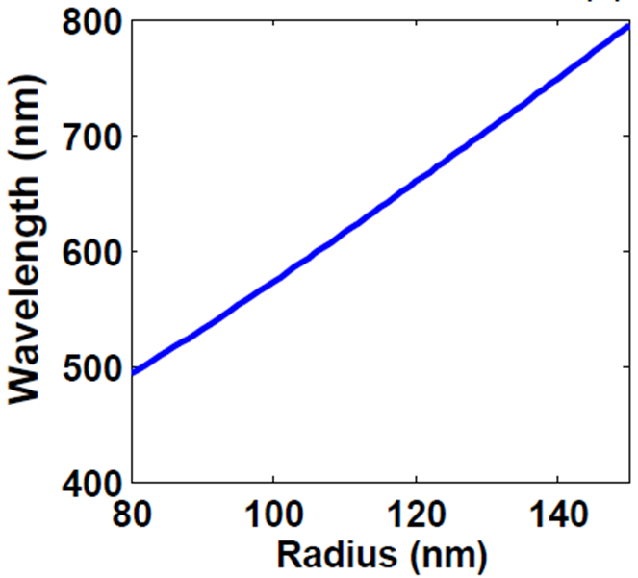
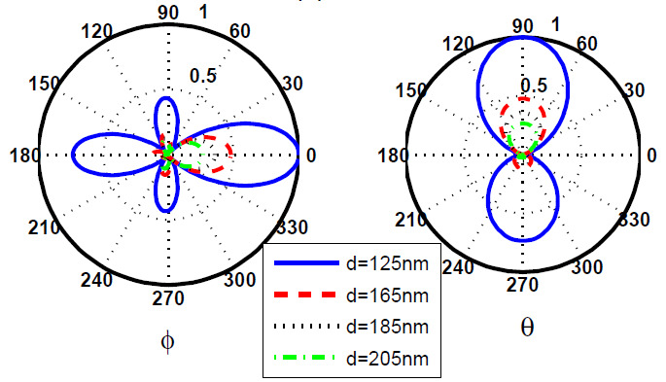
Theoretical results (3)
Fig. 5. The tunable Fano resonance by varying the sphere radius
Fig. 6. The radiation patterns at the xoy plane after modifying the separation d between the dipole emitter and the center of the sphere; The radiation patterns at the zox plane.

Slide 13
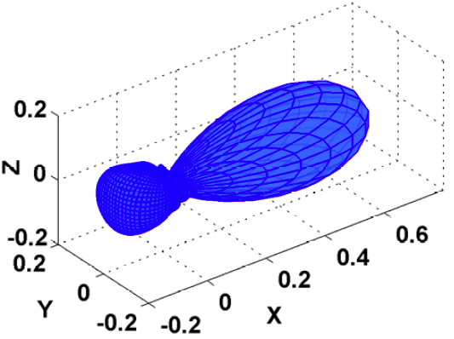
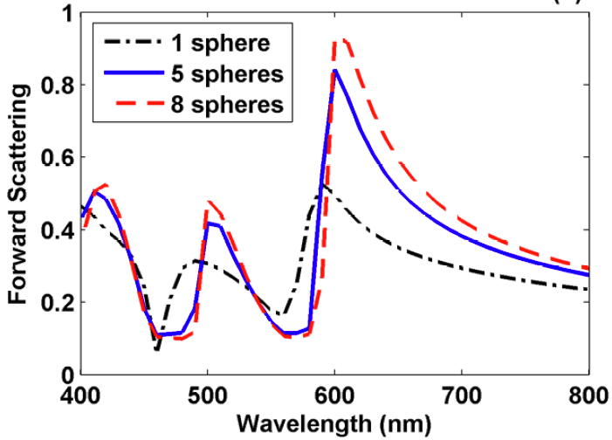
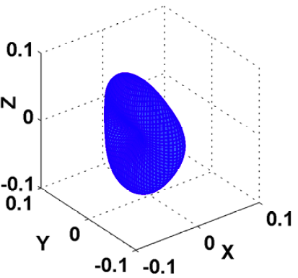
Theoretical results (4)
Fig. 8. The radiation pattern of the director working at the dipole resonance peak (603 nm)
Fig. 7. The forward scattering intensity for three directors comprising 1, 5 and 8 silicon nanospheres, respectively. The radius of each sphere is 70 nm
Fig. 9. The radiation pattern of the
director at off-resonance (565 nm)

Slide 14
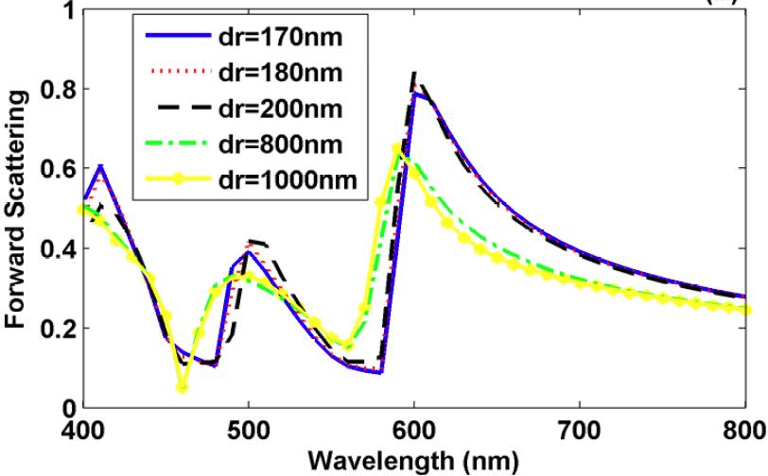
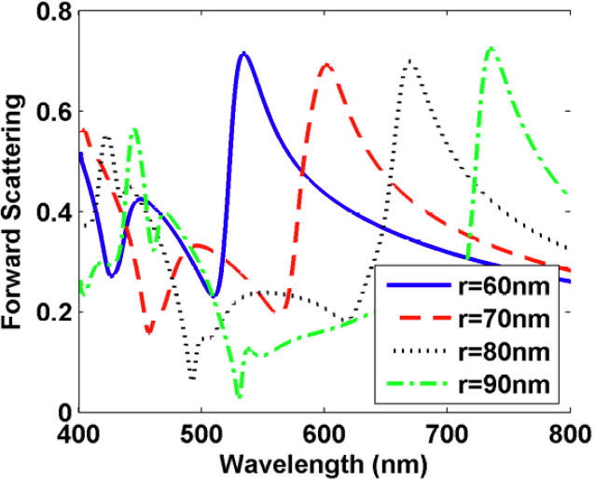
Theoretical results (5)
Fig. 10. The forward scattering intensity for the director (involving 5 silicon nanospheres) as a function of the periodicity of the sphere chain
Fig. 11. The forward scattering intensity of the director as a function of the sphere radius

Slide 15
Summary
We design a directional and selective photonic NA composed of a single sphere reflector and a sphere chain director.
The high directionality originates both from the backward reflection by the Fano resonance and from the forward direction by the dipole resonance.
The seamless wavelength selectability is realized by matching the operating wavelength of the reflector with that of the director via tuning the geometrical configurations.
The smaller loss of photonic elements, compared with the metallic ones, can induce stronger directionality.

Slide 16
Thanks for your attention!

