Slide 1
Comprehensive Study of Plasmonic Effects in Organic Solar Cells
Wei E.I. Sha¹ (沙威), Wallace C.H. Choy¹ (蔡值豪), and Weng Cho Chew² (周永祖)
1. Department of Electrical and Electronic Engineering,
The University of Hong Kong, Hong Kong
2. Department of Electrical and Computer Engineering,
University of Illinois, Urbana-Champaign,
Illinois 61801, USA
Emails: chchoy@eee.hku.hk (W.C.H. Choy); w-chew@uiuc.edu (W.C. Chew)

Slide 2
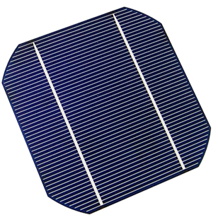
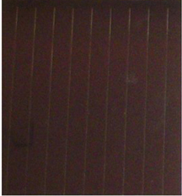
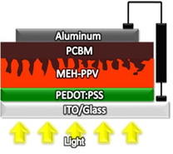
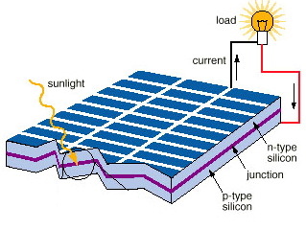
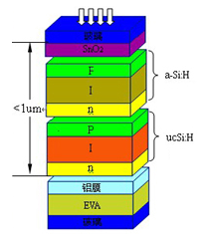
Organic Solar Cell (1)
Advances of solar cell technology
organic solar cell
monocrystalline silicon solar cell
amorphous/polycrystalline silicon solar cell

Slide 3
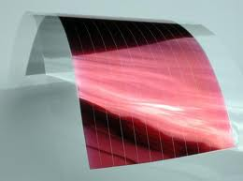
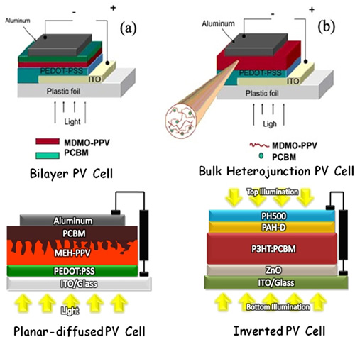
Organic Solar Cell (2)
Thin-film organic solar cell
low-cost processing
mechanically flexible
large-area application
environmentally friendly
low exciton diffusion length
low carrier mobility

Slide 4
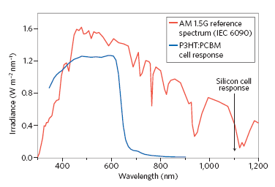
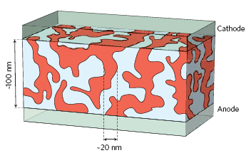
Organic Solar Cell (3)
exciton diffusion
charge separation
Working principle
charge collection
optical absorption
increase interface area

Slide 5
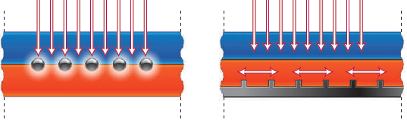
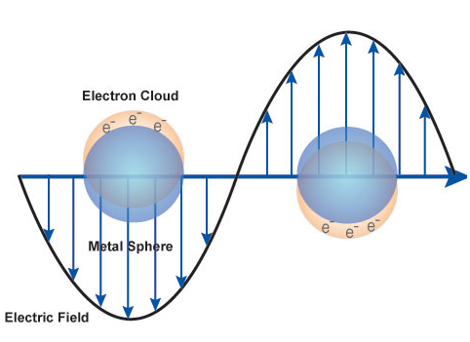
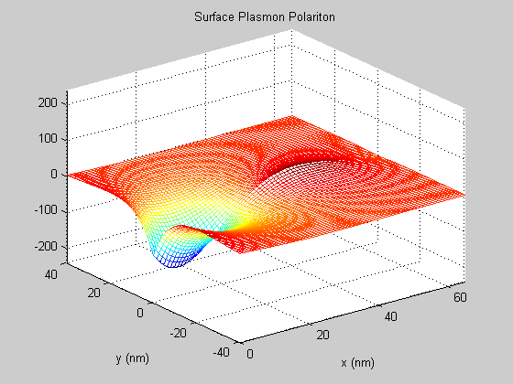
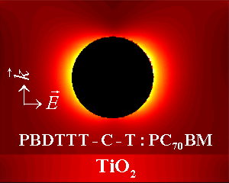
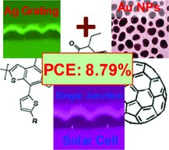
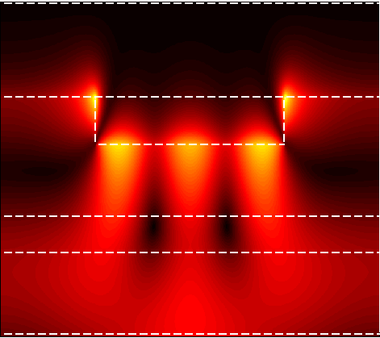
Plasmonic Organic Solar Cell
Why optical enhancement?
The thickness of the active layer must be smaller than the exciton diffusion length to avoid bulk recombination. As a result, the thin-film organic solar cell has poor photon absorption or harvesting. Plasmonic solar cell is one of emerging solar cell technologies to enhance the optical absorption.
nanoparticles: local plasmon
nanograting: surface plasmon

Slide 6
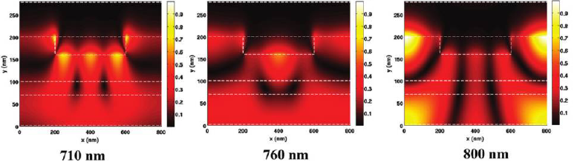
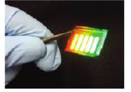
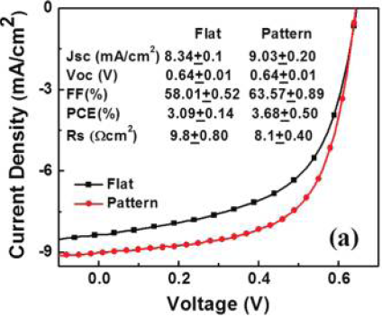

X.H. Li, W.E.I. Sha, W.C.H. Choy, etc, J. Phys. Chem. C, 116(12), 7200-7206, 2012.
Plasmonic band edge boosted optical enhancement (theory and experiment)
finite-difference frequency-domain method (TE&TM)

Slide 7
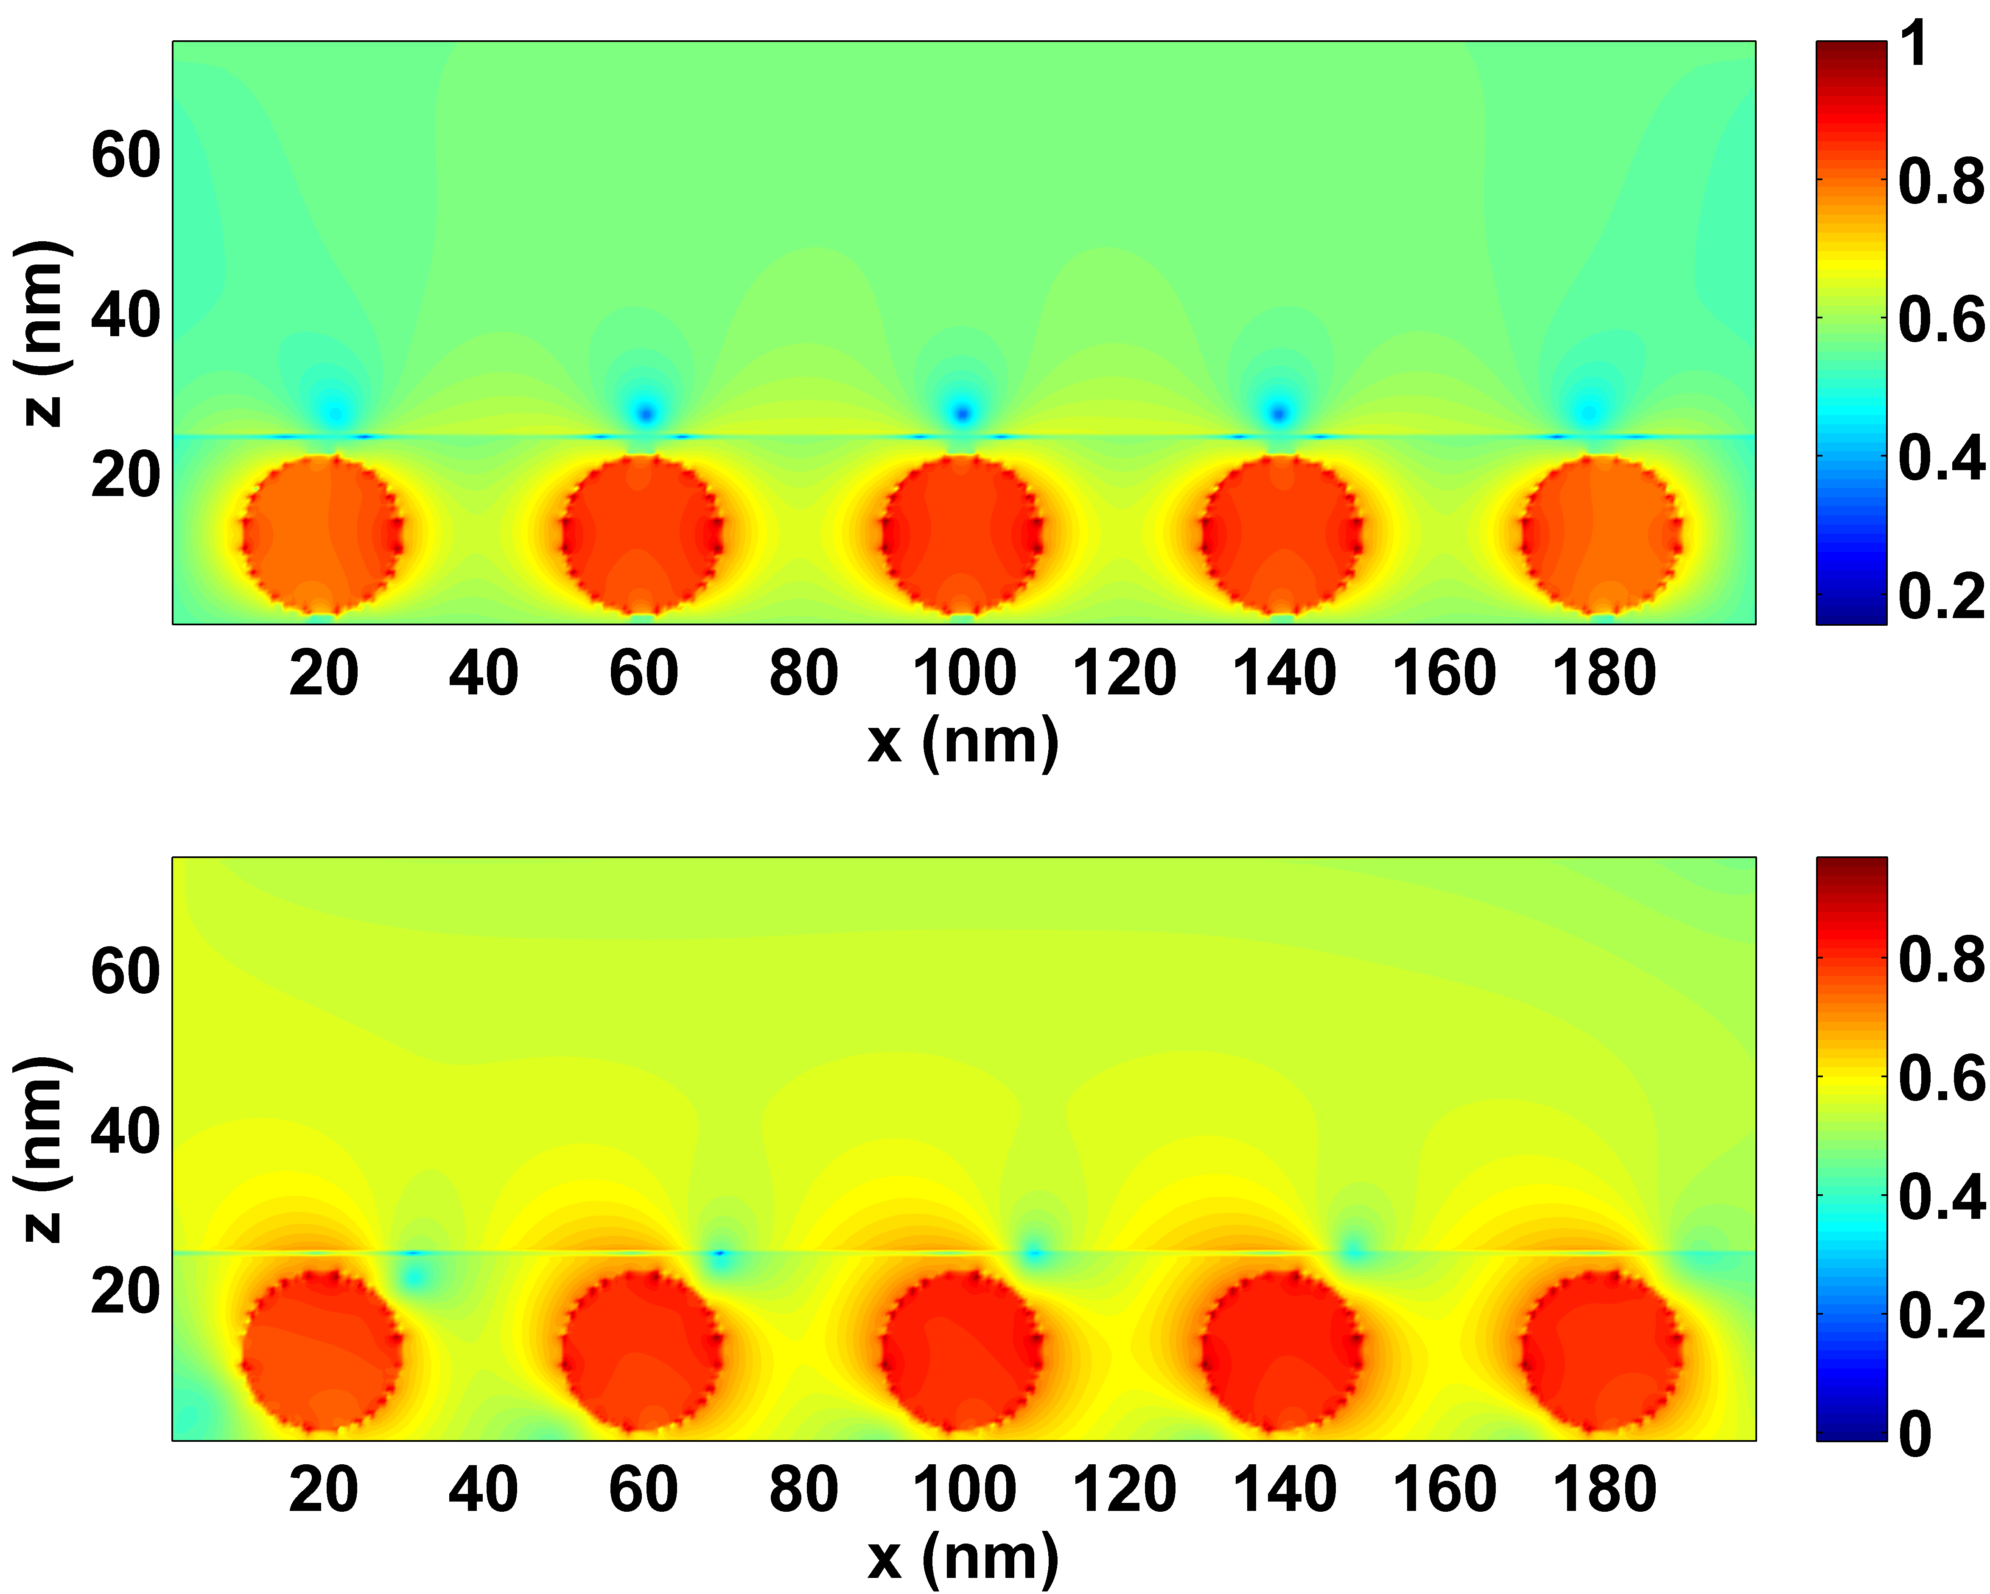
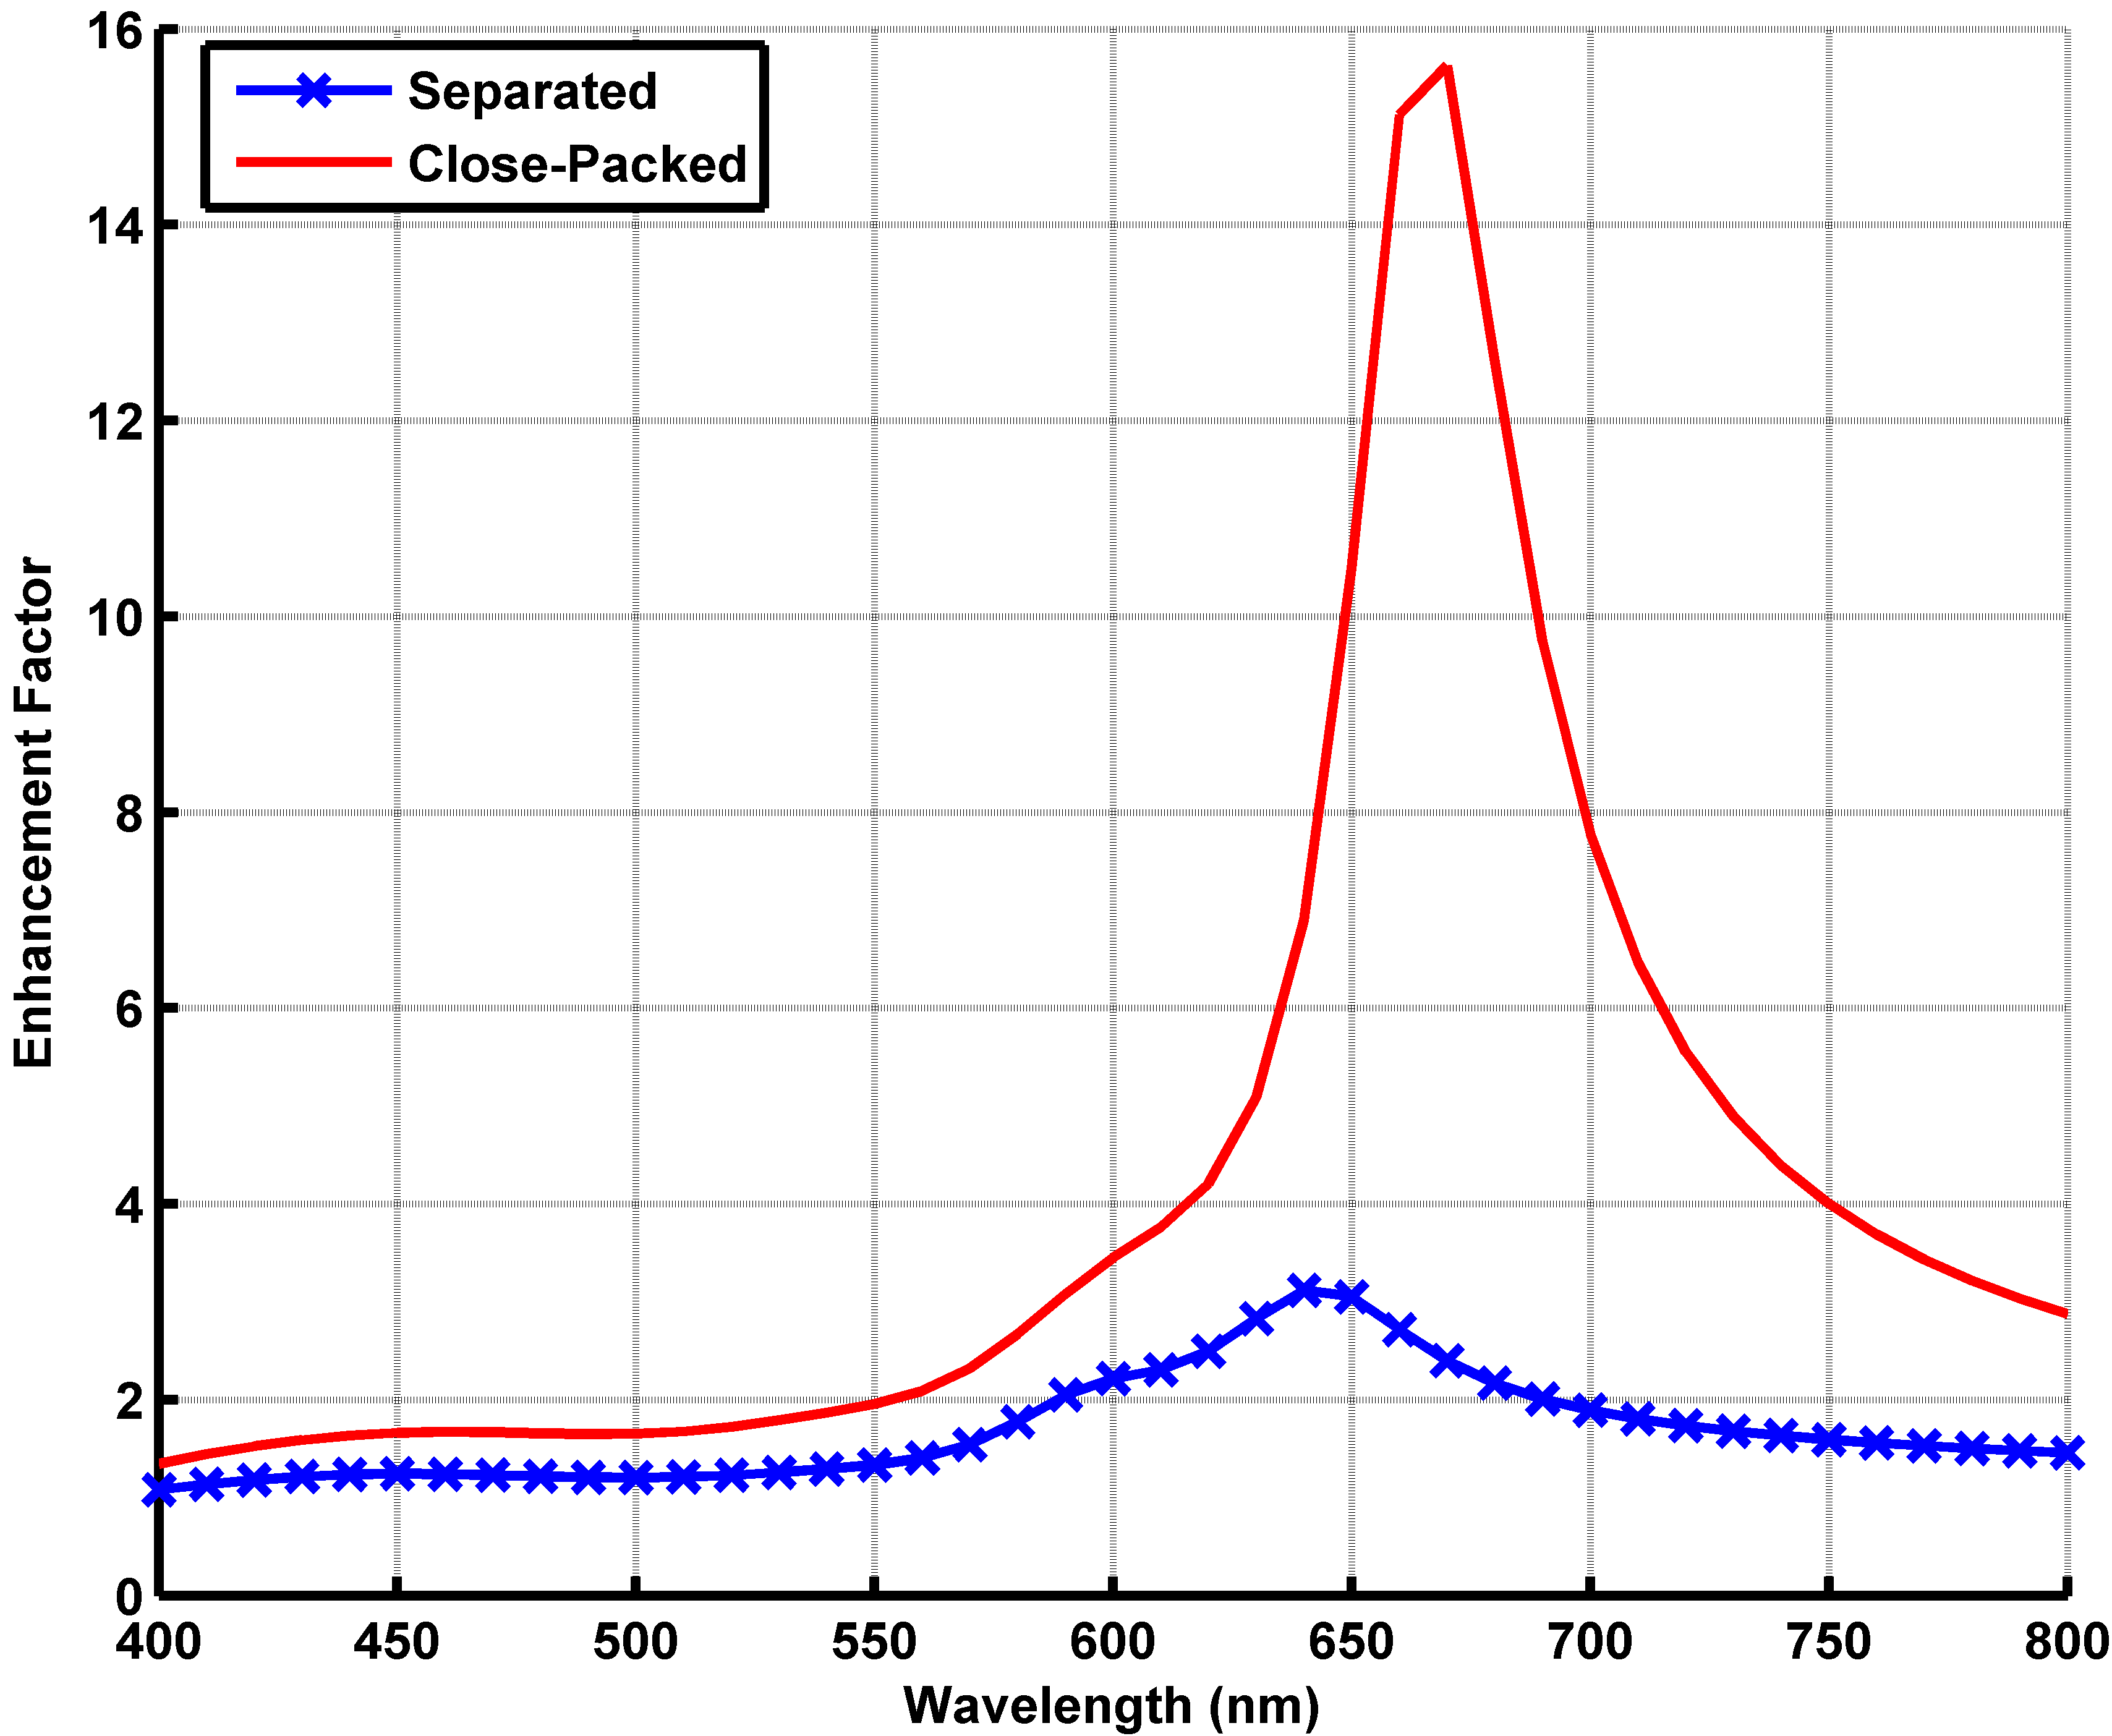
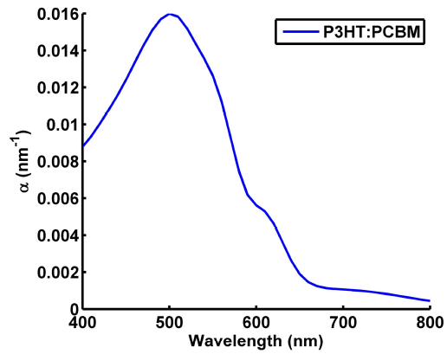
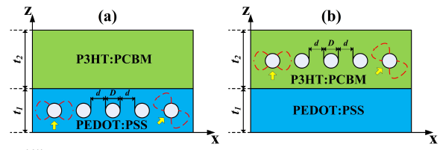
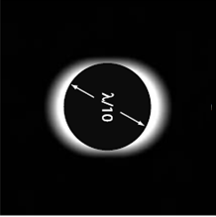
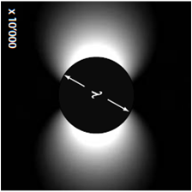
W.E.I. Sha, W.C.H. Choy, Y.P. Chen, and W.C. Chew, Appl. Phys. Lett., 99(11), 113304, 2011.
Bulk heterojunction polymer solar cell
2 fold increase in total absorption!
lateral distribution
concentration
dependent
direction dependent
k
k
VIE-FFT method (BiCG-STAB)
Near-field
Far-field

Slide 8
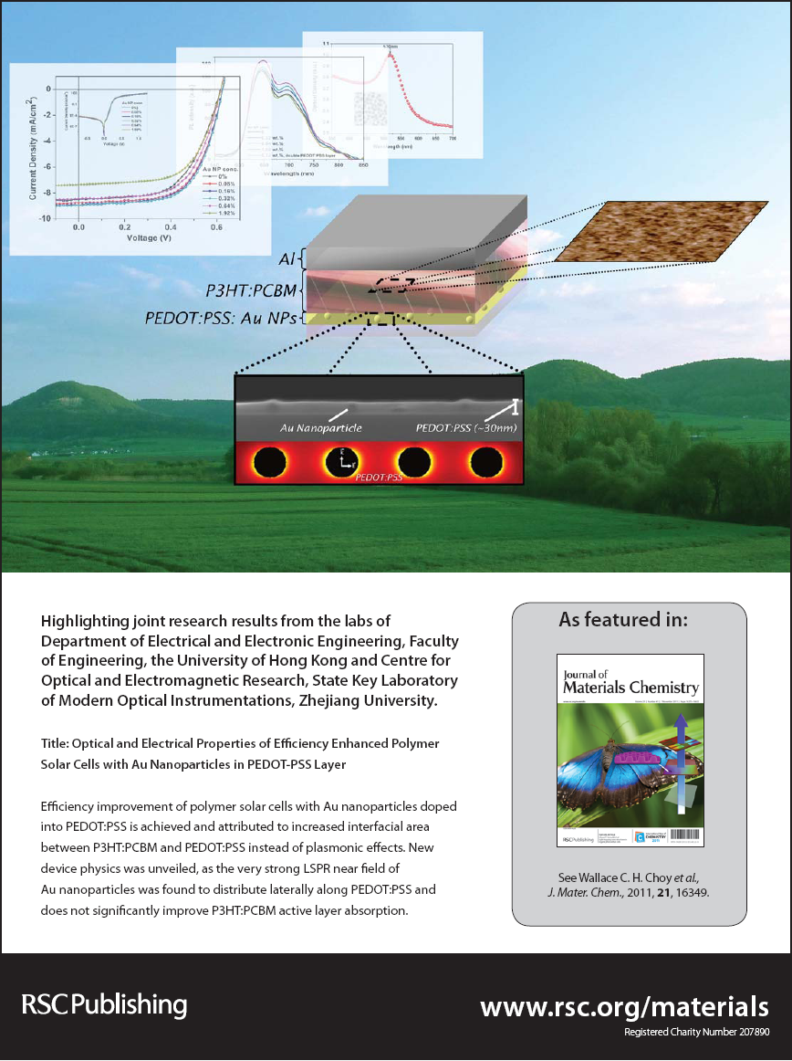
Comparisons with experimental results
C.C.D. Wang, W.C.H. Choy, etc, J. Mater. Chem., 22, 1206-1211, 2011.
D.D.S. Fung, L.F. Qiao, W.C.H. Choy, etc, J. Mater. Chem., 21, 16349-16356, 2011.
nanoparticles in spacer layer
Selected as Back Cover
and Hot Article in
Journal of Material Chemistry
nanoparticles in active layer

Slide 9
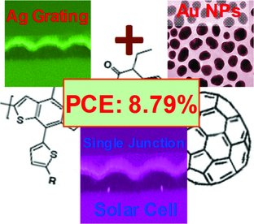
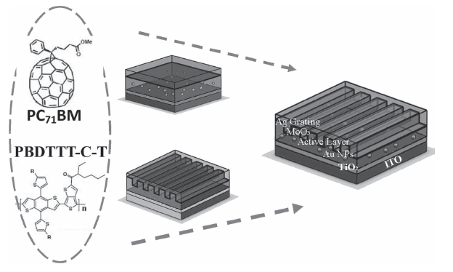
X.H. Li, W.C.H. Choy, L.J. Huo, F.X. Xie, W.E.I. Sha, B.F. Ding, X. Guo, Y.F. Li, J.H. Hou, J.B. You, and Y. Yang, Adv. Mater., 24, 3046–3052, 2012.
Dual Plasmonic Nanostructure (experimental results)
power conversion efficiency 8.79%
Spin-coating+nanoimprinting

Slide 10
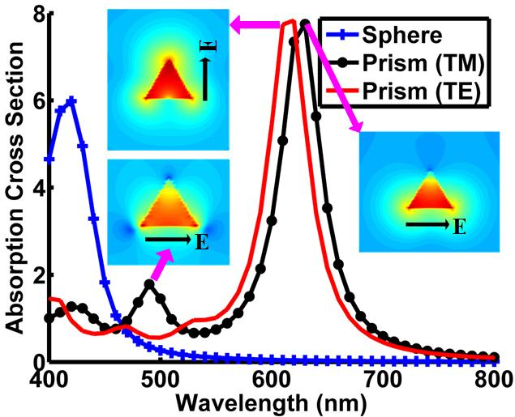
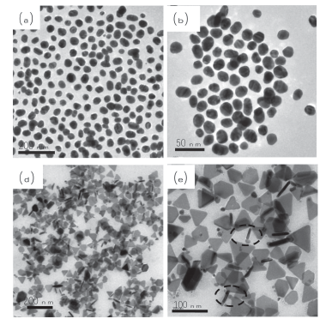
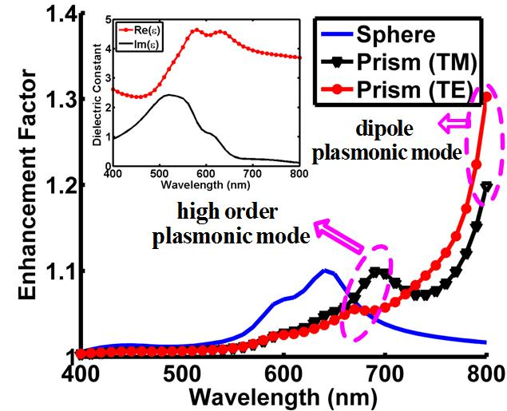
X.H. Li, W.C.H. Choy, H.F. Lu, W.E.I. Sha, and A.H.P Ho, Adv. Funct. Mater., 23(21), 2728–2735, 2013
Shape-Dependent Broadband Plasmonic Resonances
Ag spherical and triangular nanoparticles

Slide 11
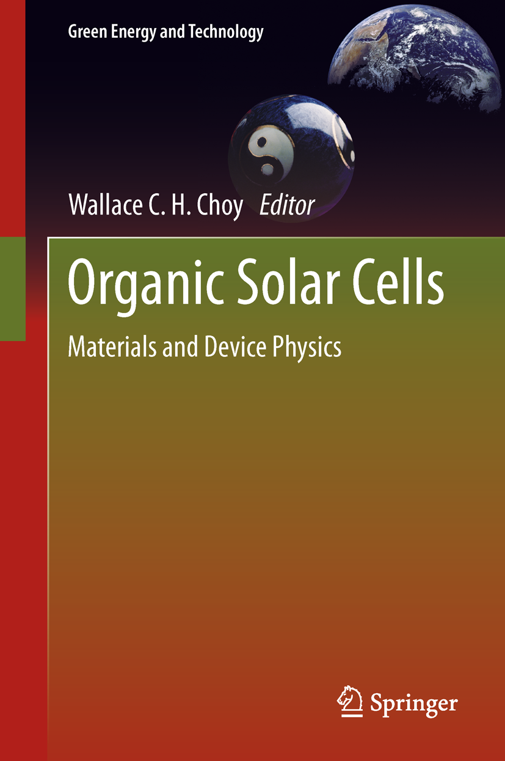
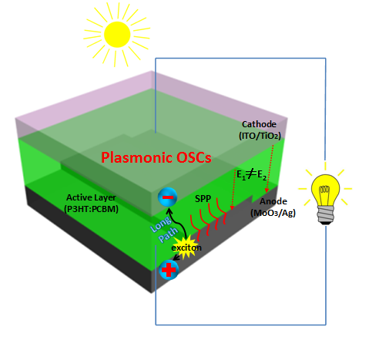
Could electrical properties of OSCs be affected by introducing the metallic nanostructures?
Wei E. I. Sha, Wallace C. H. Choy and Weng Cho Chew, “Theoretical Studies of Plasmonic Effects in Organic Solar Cells”, Chapter 7, Organic Solar Cells: Materials and Device Physics, Pages 177-210, Wallace C.H. Choy (Ed.), ISBN 978-1-4471-4823-4, Springer, 2013.

Slide 12
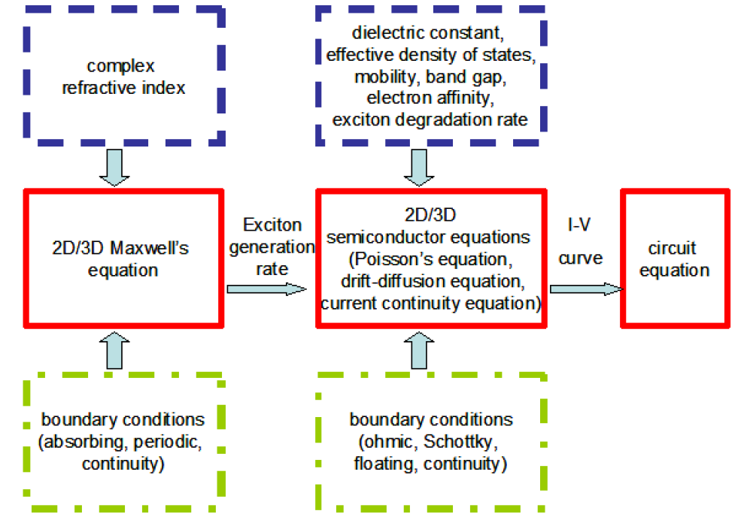
Multiphysics Model (1)
Schematic diagram
W.E.I. Sha, W.C.H. Choy*, Y.M. Wu, and W.C. Chew, Opt. Express, 20(3), 2572-2580, 2012.

Slide 13


Multiphysics Model (2)
Governing equations
frequency dependent permittivity
Maxwell’s equation
optical electric field
generation rate
Generation rate
electrostatic potential
electron density
bimolecular recombination rate
electrostatic dielectric constant
semiconductor equations
hole density
mobility
Diffusion coefficients
exciton dissociation probability

Slide 14
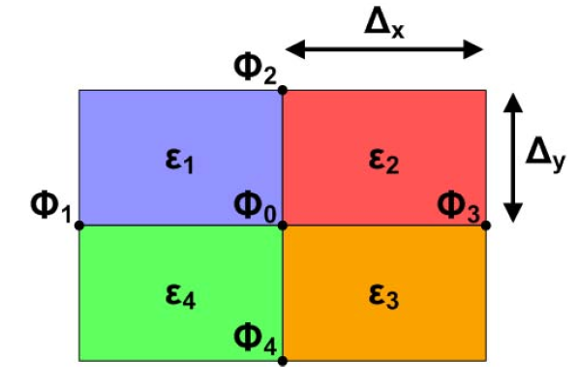
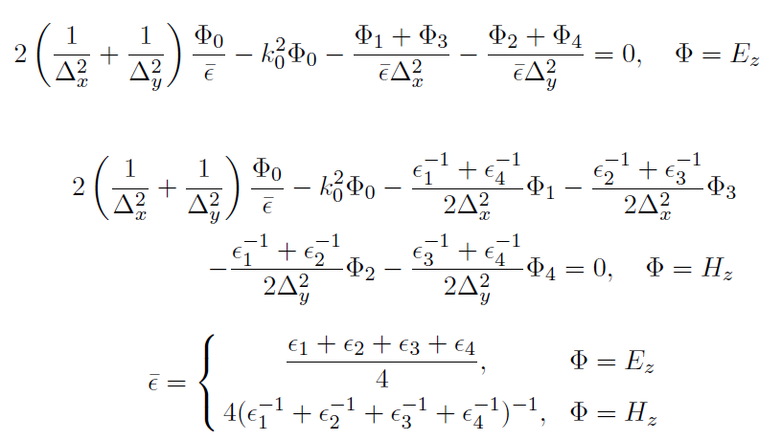
Multiphysics Model (3)
Unified finite difference method
optical properties
spatial step depends on the dielectric wavelength and skin depth of surface plasmons
2D wave equations: TE & TM
periodic boundary conditions
stretched-coordinate perfectly matched layer

Slide 15
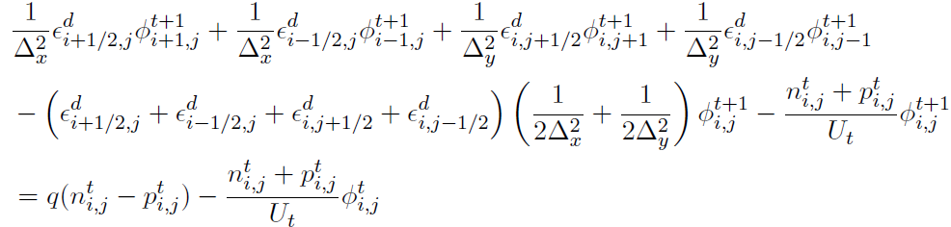
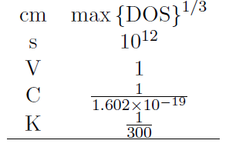
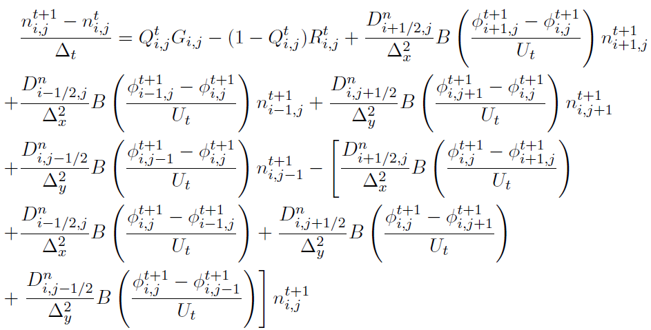

Multiphysics Model (4)
Poisson equation (Gummel’s method)
electrical properties
spatial step depends on the Debye length
scaling unit
drift-diffusion and continuity equations of electron
(Scharfetter-Gummel scheme in spatial domain
semi-implicit strategy in time domain)
Dirichlet and Neumann
boundary conditions
time step for stable algorithm

Slide 16
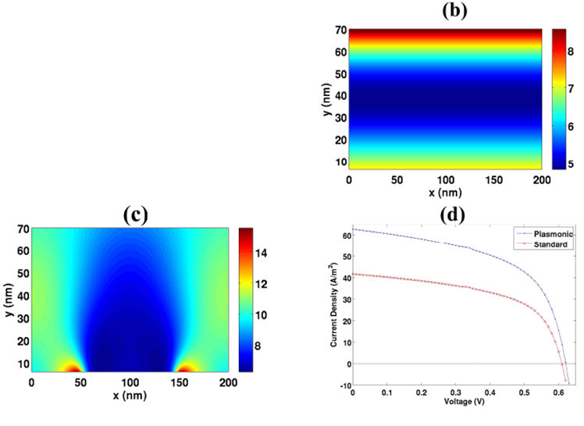
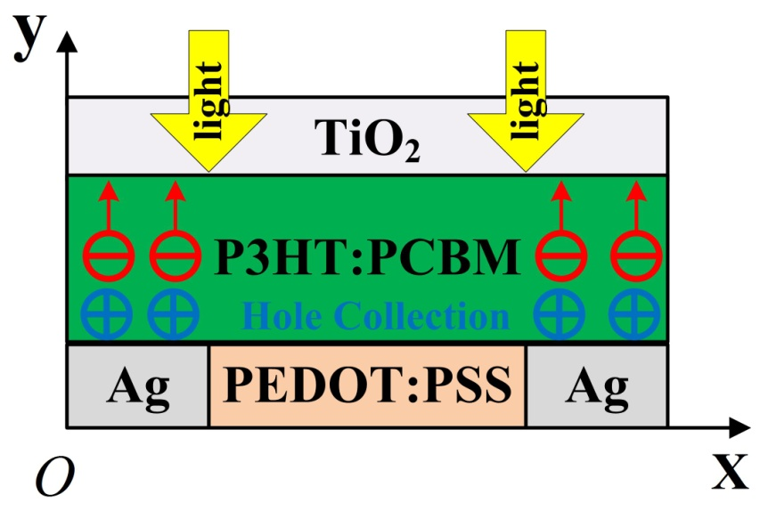
Multiphysics Model (5)
Beyond optical absorption enhancement: facilitating hole collection!
schematic pattern of nanostrip plasmonic cell
Model settings
active layer thickness
70 nm
periodicity
200 nm
PEDOT:PSS width
100 nm
anode
ohmic
cathode barrier height
0.2 eV
hole mobility
0.1*electron mobility
effective band gap
1.1 eV
(a)
active layer of
standard cell
active layer of
plasmonic cell

Slide 17
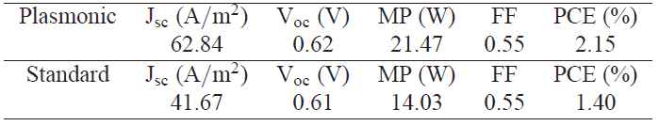
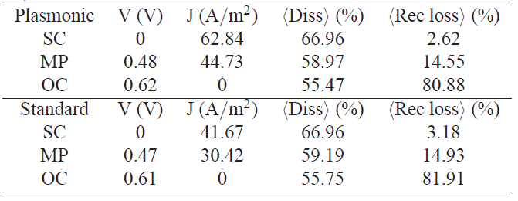
Multiphysics Model (6)
Characteristic parameters
reduce recombination loss
increase short-circuit current
improve open-circuit voltage
boost power conversion efficiency

Slide 18
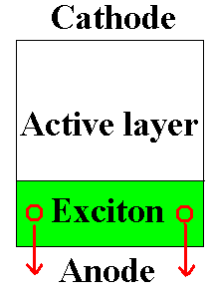

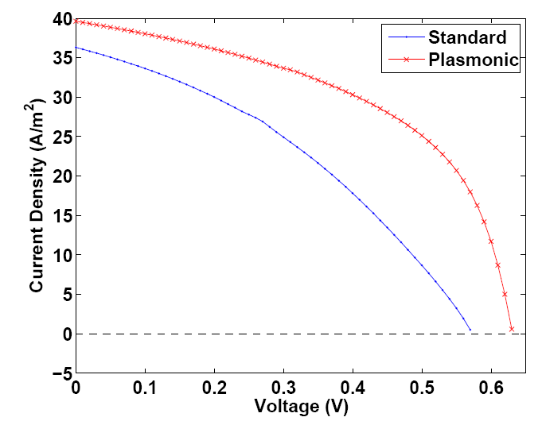
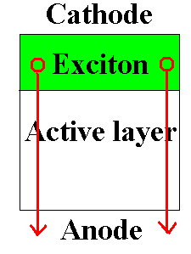

Multiphysics Model (7)
Dummy case for further illustrating physics (hole transport and collection)
J-V curve
inhomogeneous exciton generation significantly affects
fill factor and
open-circuit voltage
hole mobility is set to be two order
of magnitude lower than electron mobility

Slide 19
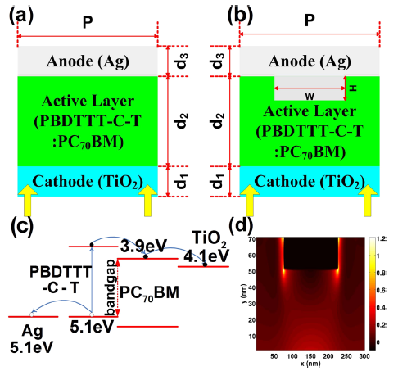
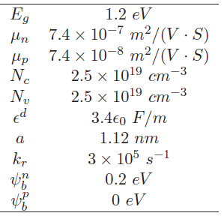
Multiphysics Model (8)
The nanograting structure v.s. flat standard structure
Simulation parameters

Slide 20
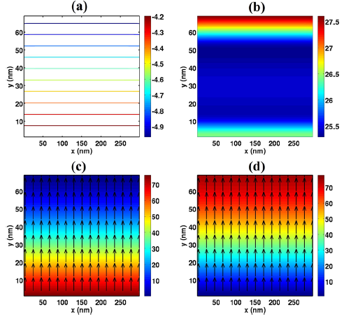
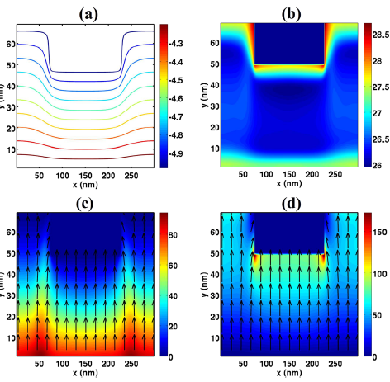
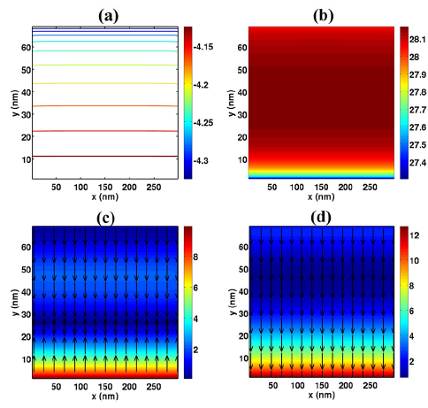

Multiphysics Model (9)
short-circuit
(a) equipotential lines; (b) recombination rate; (c,d) electron and hole current densities.
open-circuit

Slide 21




Multiphysics Model (10)
Jsc
The grating anode induces nonuniform optical absorption and inhomogeneous internal E-field distribution. Thus uneven photocarrier generation and transport are formed in the plasmonic OSC leading to the dropped FF.
Voc
W.E.I. Sha, W.C.H. Choy*, and W.C. Chew, Appl. Phys. Lett., 101, 223302, 2012.
recombination and exciton dissociation

Slide 22
Conclusion
Environmentally friendly organic solar cell (OSC), which has a bright outlook to meet the urgent demand in clean energy, draws much attention in recent years due to their merits of large-area production, low-cost processing and mechanical flexibility. Proposing and optimizing new device architectures plays a key role in designing high-performance OSCs.
A multiphysics study carries out on plasmonic OSCs by solving Maxwell's equations and semiconductor (Poisson, drift-diffusion, and continuity) equations simultaneously with a unified finite-difference framework.
Nonuniform distributions of optical near-fields induced by plasmonic nanostructures will significantly affect the carrier transport in OSCs. Besides their optical effects, the electrical effects induced by plasmonic resonances will open up a new way to design emerging plasmonic organic photovoltaics.

Slide 23
Acknowledgement
Thanks for your attention!

